Slide 1
HAZARDOUS WASTE MANAGEMENT
By
Dr. Zaryab Khalid
Class: MS Botany
Semester: II
Subject: Environmental Biotechnology

Slide 2

HAZARDOUS WASTE MANAGEMENT
DEFINITION: Any residues or combination of residues otherthan radioactive waste which by reason of its chemical reactivity or toxic, explosive, corrosive or other characteristics causes potential hazard to human or environment, either alone or when in contact with other wastes and which therefore cannot be handled, store, transported, treated or disposed off without special precautions.

Slide 3
SOURCES:
Inorganic &organic chemicals
Petroleum refineries
Iron & steel
Non ferrous metals
Leather tanning
Metal finishing.

Slide 4

HAZARDOUS WASTE CLASSIFICATION:
IGNITABILITY
CORROSIVITY
REACTIVITY
TOXICITY
-IGNITABLE WASTES
-CORROSIVE WASTE
-REACTIVE WASTE
-TOXIC WASTE

Slide 5

RULES & REGULATIONS OF HW:
Aim at providing control
Specify the responsibilities
Regulations governing generators of HW 1.preparation for transport
2.manifest requirements 3.record keeping & reporting
Regulations governing transporters of HW
  notification prior to transport 2.manifest requirements

Slide 6
TRANSPORTATION & STORAGE OF HW:
The CRADLE TO GRAVE concept
HW generated at source requires movement by trucks to further.
Requires serious care & attention while moving
HW to be properly packed & labelled for transport to ensure safe handling
Storage facilities are used to store waste temporarily before treatment & disposal.

Slide 7

HAZARDOUS WASTE MANAGEMENT STRATEGY:
OBJECTIVES:
Waste minimization
Detoxification & neutralization of waste by treatments
Destruction of combustible waste by incineration
Solidification of sludge & ash from steps from 2 & 3
Disposal of residues in landfills.

Slide 8

1.Waste minimization:
helps in resource conservation, economic efficiency & environmental protection.
The strategies include—
source reduction, recycling and waste exchange

Slide 9

2. TREATMENT METHODS:
Physical Chemical and
biological treament

Slide 10

Physical treatment :
Involves variety of seperation techniques
Whenever a waste containing liquid & solid must be treated.
Physical processes are
Screening, sedimentation, centrifugation, flotation, adsorption, stripping and RO.

Slide 11

Chemical treatment:
To make the complete breakdown of HW into non toxic form and
To reduce the hazard of a particular waste
Chemical methods are ::
Neutralization, precipitation, oxidation and reduction.

Slide 12

Neutralization: carried out when the waste contains excessive amount of acid or alkali.
Chemical oxidation:used to destroy toxic cyanide molecule with oxidising agents
Reduction: used in the conversion of hexa valent chromium into trivalent chromium before it can be precipitated.
Anodic electrolysis: used for the destruction of cyanide in spent stripping & plating solutions.

Slide 13

Biological treatment:
Differnet types of microorganisms are used for degradation of specific compounds of HW
Some microbes found in soil & sewage sludge have been tested in the degradation of organic chemicals
Tests have been conducted to degrade PCBs using pseudomonas & flavo bacterium.
Psuedomonas bacteria – benzene, phenol ,cresol.

Slide 14

3. INCINERATION:
able to achieve 99.99% destruction & removal efficiency of hazardous components in waste.
Primary products are CO2, vapour & ash
Sulphur bearing wastes gives off SO2, CO2, H2O when incinerated.
By products of incomplete combustion are sometimes more harmful.
Two types of incinerators: liquid injection system, rotary kilns.

Slide 15
4.Solidification or Stabilization:
Convert the waste into an insoluble,rock hard material.
Additive materials used to reduce the mobility of pollutants in the waste.
Certain materials like nickel cannot be destroyed or detoxified by above methods.
The residues that are left out are solidified to reduce the leachability.

Slide 16
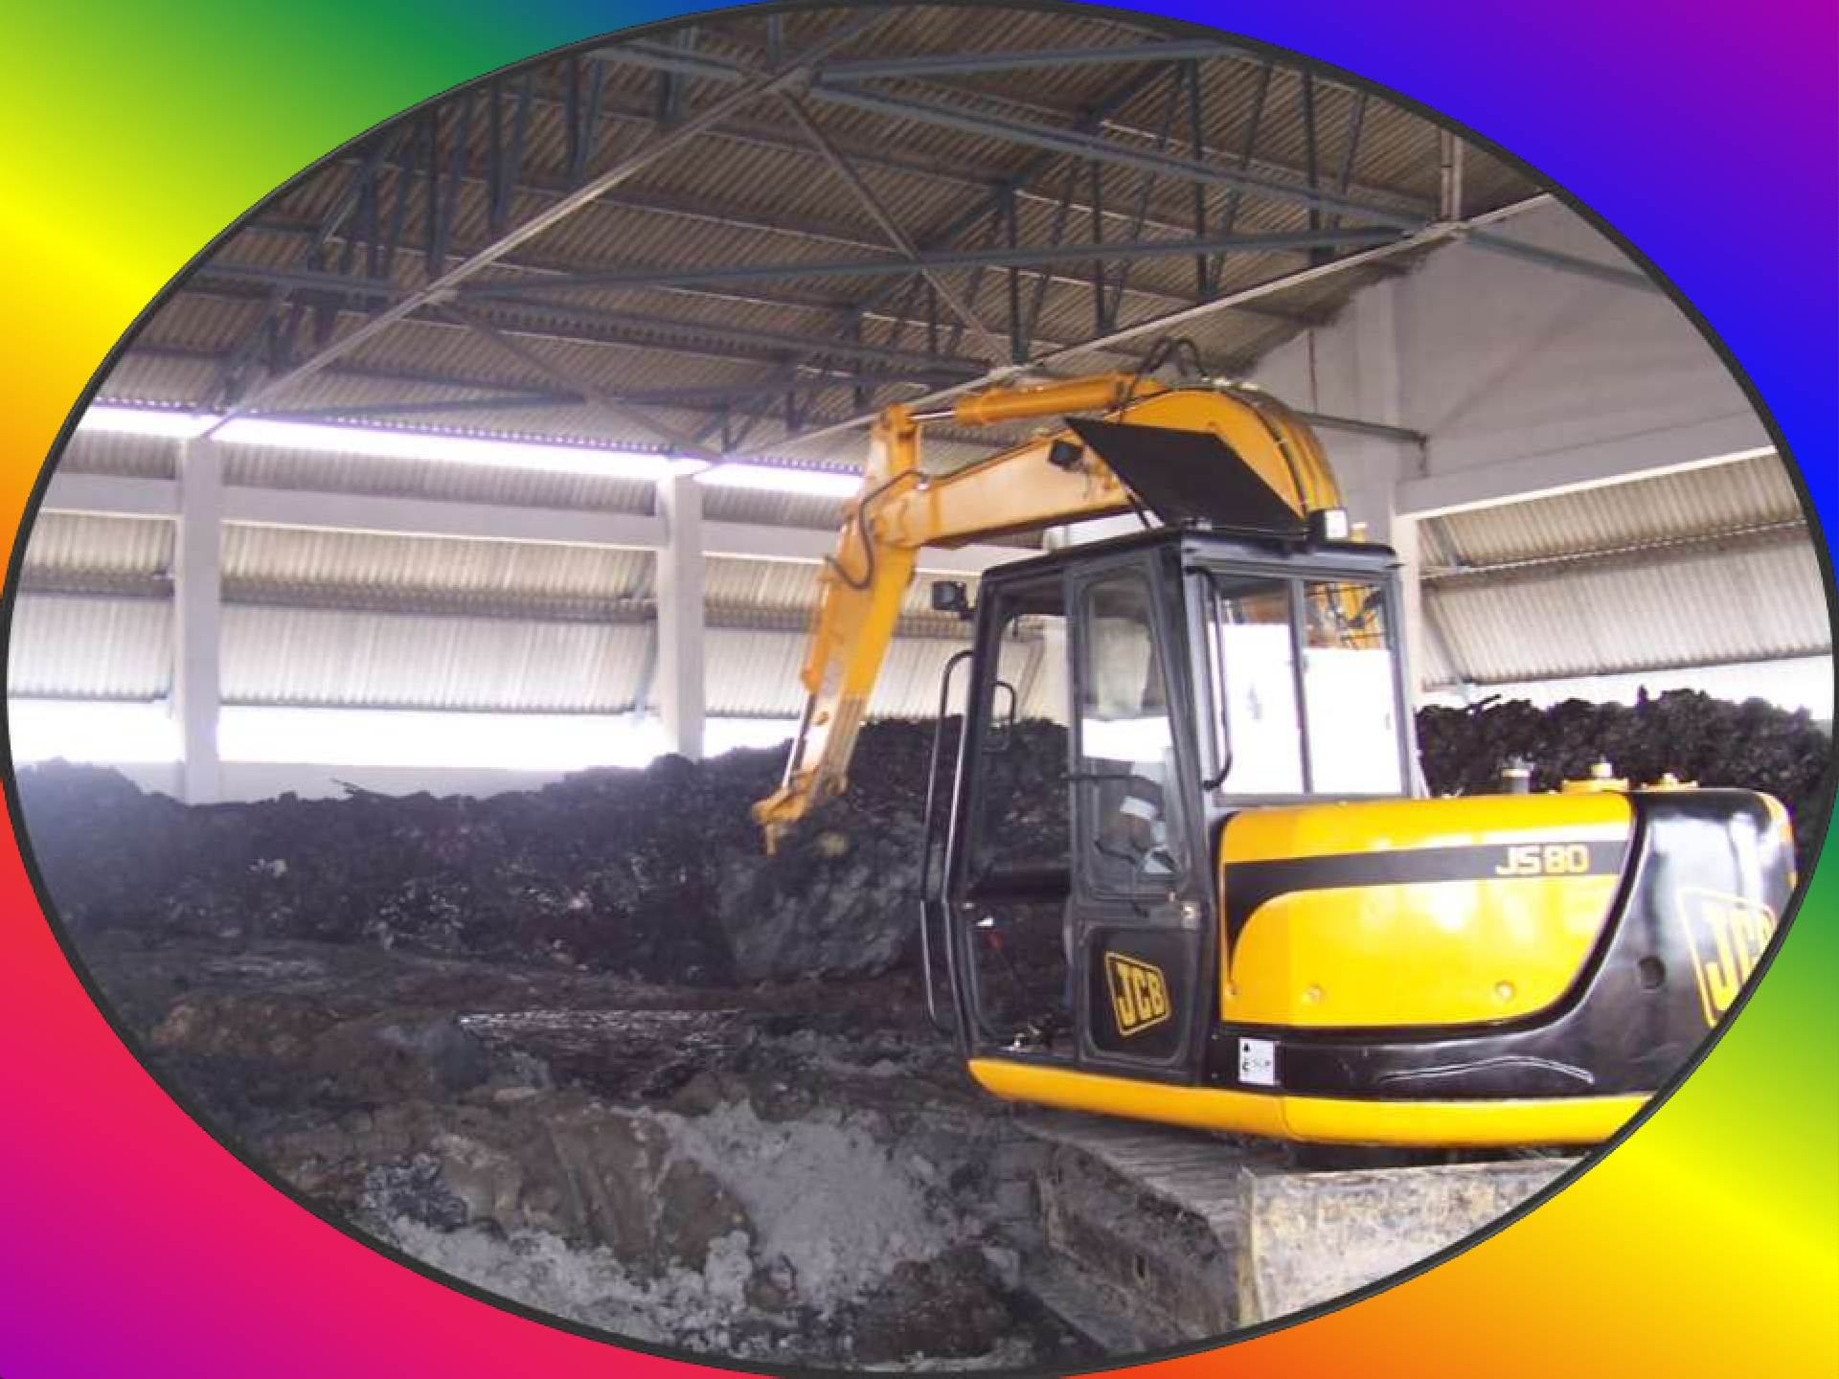

Slide 17
5.DISPOSAL METHODS:
The options for disposal include land disposal, underground disposal & deep well injection.
The choice of disposal method should be based on evaluation of economics & potential pollution risks.
To prevent environmental pollution from landfills , it is essential that site c/s are taken into account.

